Slide 1

Tabletop Torsion Device
Midterm Presentation II
By: Brendan Keane, Logan M^{c}Call, Reggie Scott, Mark Swain
Instructors: Dr. Scott Helzer and Dr. Nikhil Gupta
Sponsor: Mr. Philip Flater (Munitions Directorate Eglin AFB) Advisor: Dr. Simone Hruda

Slide 2
Overview
Background with Constraints
Statements
  Need Statement
  Goal Statement
Challenges and Considerations
  Breakdown
  Components
  Decision Matrices
Optimal Design Selection
Plan of Action
  Gantt Chart
Conclusion
Reggie Scott

Slide 3
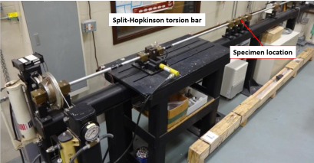
Background with Constraints
Existing test hardware at Eglin AFB is not well-suited for characterizing relatively-small test samples that have been fabricated from plate or bar stock
Maximum of 250Nm axial loading (Torque) by the machine
Budget - $2,000
Machine must fit in an area (footprint) of 1m²
Monotonic(one direction), and Cyclic(two direction) Free-End Torsion Loading
Axial 1 DoF
Figure 2.1: Existing Torsion Machine
Reggie Scott
Notes:
The reason for limited plate thickness is not a matter of cost, however it is a matter of geometry. When the Munitions Directorate is fabricating components of the munitions they use raw stock that is as close to final shape as possible to conserve waste material. In order to properly characterize the materials that end up in a product they have to simply test similar geometry in order the get accurate results.

Slide 4
Statements
Need Statement
  The current torsion machine at the Eglin Air Force Base is ineffective when testing small specimens.
Goal Statement
  Design a more effective way of testing small specimens in free-end torsion.
Reggie Scott

Slide 5
Breakdown of Challenges
Torsion Tester
Load Generation
Manual Power
Load Measurement
Linear Motion
Sensors
Gripping Mechanism
Load Application
Friction Reduction
Motor & Transmission
User interface
Housing
Material Selection
User Safety
Reggie Scott

Slide 6
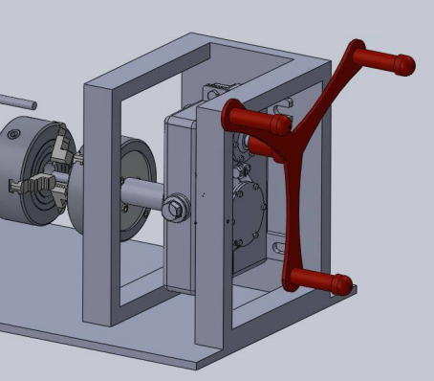
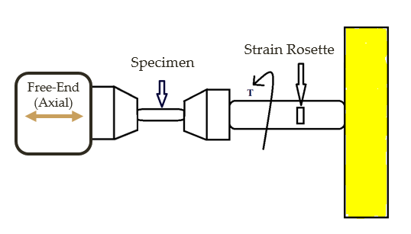
Load Generation Options
Crank System
Pros
  Cost effective
  Less maintenance
  No program experience needed
Cons
  Inaccurate
  User fatigue
  Not safe
Figure 5.1: Potential crank system configuration
Reggie Scott

Slide 7
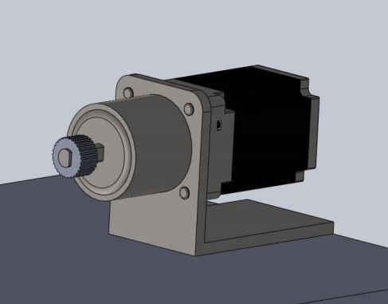
Load Generation Options
Pros
  Variability
  Repeatability
  Accuracy
  Ease of use
Cons
  Requires programming
  Maintenance
  Cost
DC Motor
Figure 6.1: CAD model of a DC motor and attached gearbox
Reggie Scott

Slide 8
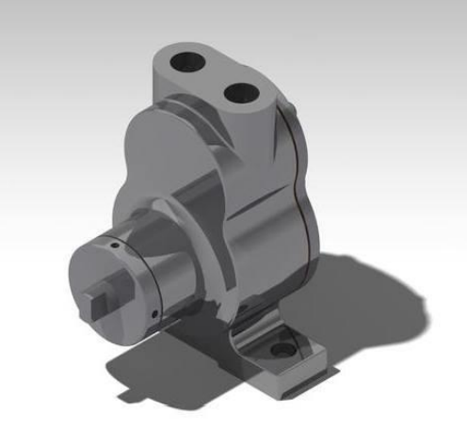
Load Generation Options
Hydraulic System
Pros
  Variability/Repeatability
  Accuracy
  High load capability
Cons
  Maintenance
  Complex components
  Cost
Figure 7.1: CAD model of a pump necessary for a hydraulic system
Reggie Scott

Slide 9
Load Generation Selection
Design | Cost | Weight | Accuracy | Complexity | Maintenance | Variability | Total
Weight Factor | 0.25 | 0.05 | 0.25 | 0.1 | 0.1 | 0.25
Crank System | 5 | 3 | 1 | 5 | 5 | 1 | 2.9
Hydraulic | 1 | 1 | 5 | 1 | 1 | 5 | 3
DC Motor | 3 | 3 | 5 | 3 | 3 | 5 | 4
Reggie Scott

Slide 10
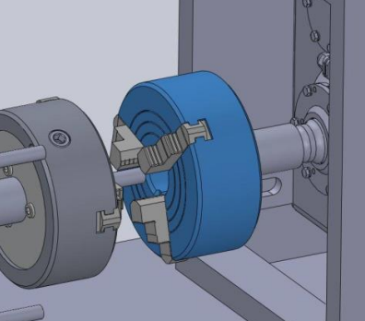
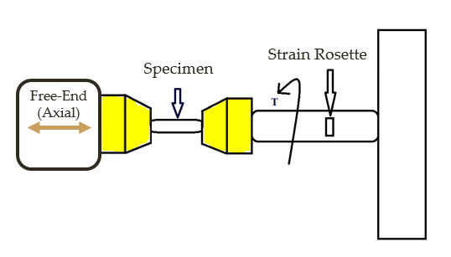
Load Application Options
3-Jaw Chuck
Pros
  Self-centering
  Variability
  Easy to use
Cons
  Cost
Figure 9.1: CAD rendering of a 3-Jaw chuck
Reggie Scott

Slide 11
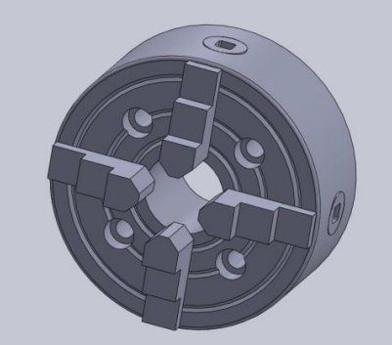
Load Application Options
4-Jaw Chuck
Pros
  Better Load Disbursement
  Easy To Use
Cons
  Cost
  Not Self Centering
  Limited Specimen Geometry
Figure 10.1 CAD rendering of a 4-jaw chuck
Reggie Scott

Slide 12
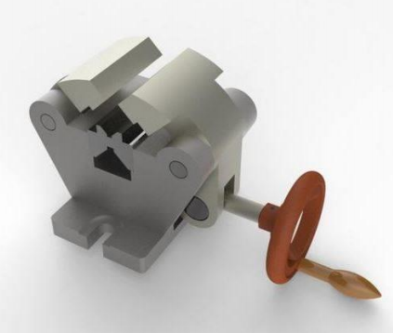
Load Application Options
Self-Aligning Vise
Pros
  Simplicity
  Self-aligning
  Strong holding force
Cons
  Weight
  Size
Figure 11.1: CAD rendering of a self-aligning vise
Reggie Scott

Slide 13
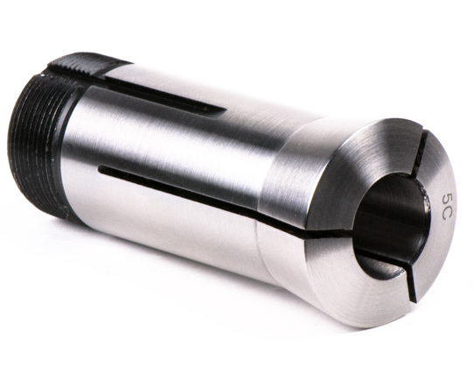
Load Application Options
Pros
  Cost
  Weight
  Simplicity
Cons
  Variability
Collet
Figure 12.1: Collet used for gripping round specimens
Reggie Scott

Slide 14
Load Application Selection
Design | Cost | Weight | Reliability | Complexity | Variability | Total
Weight Factor | 0.25 | 0.15 | 0.3 | 0.1 | 0.2
3-Jaw Chuck | 5 | 5 | 5 | 3 | 5 | 4.8
4-Jaw Chuck | 3 | 5 | 5 | 3 | 1 | 3.5
Self-Aligning Vise | 3 | 1 | 3 | 5 | 5 | 3.3
Collet | 5 | 5 | 5 | 3 | 1 | 4
Reggie Scott

Slide 15
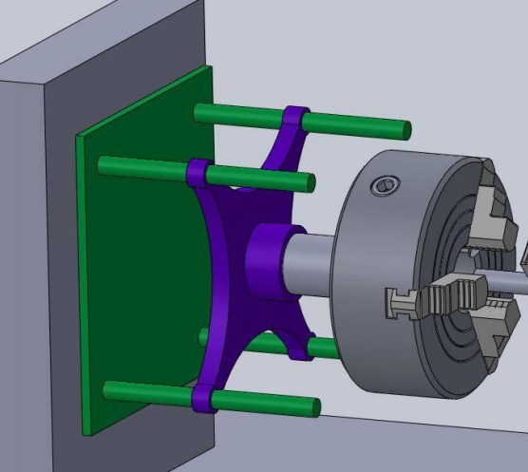
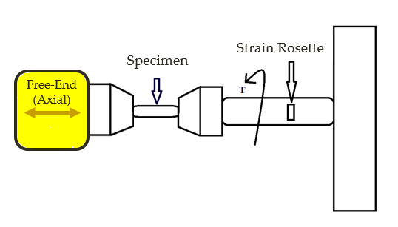
Linear Motion Options
4 Rail Ball Bearing Guide
Pros
  Load disbursement
Cons
  Weight
  Cost
  Hard to install
Figure 14.1: Potential linear motion guidance system utilizing 4 rails
Brendan Keane

Slide 16
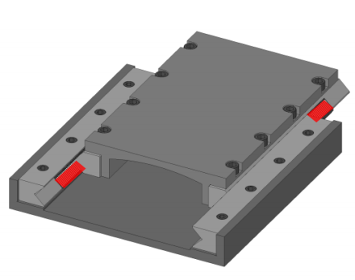
Linear Motion Options
2 Track Roller Bearing
Pros
  Load absorption
  Simplicity
Cons
  Weight
  Cost
Figure 15.1: Potential linear motion system that utilizes track roller bearings
Brendan Keane

Slide 17
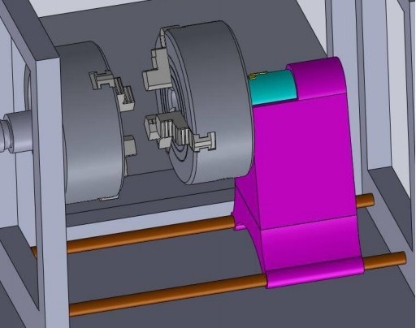
Linear Motion Options
Pros
  Cost
  Lightweight
  Simplicity
Cons
  Have to select strong shafts
  Any deformation of shaft is unusable
2 Rail Ball Bearing Guide
Figure 16.1: Potential linear motion system utilizing a 2 rail system
Brendan Keane

Slide 18
Linear Motion Selection
Design | Cost | Weight | Durability | Complexity | Total
Weight Factor | 0.4 | 0.2 | 0.2 | 0.2
4 Rail Ball Bearing Guide | 1 | 2 | 1 | 1 | 1.4
2 Track Roller Bearing Guide | 3 | 5 | 5 | 5 | 4.2
2 Rail Ball Bearing Guide | 5 | 5 | 3 | 3 | 4.2
Brendan Keane

Slide 19
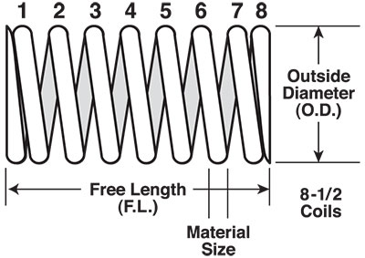
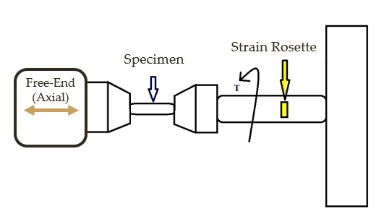
Load Measurement Options
Torsional Spring
Pros
  Accurate
  Installation
Cons
  Unusable if deformed
  Maintenance
Figure 18.1 Schematics of a torsional spring that may be used for load measurement
Brendan Keane

Slide 20
Load Measurement Options
Strain Rosette
Pros
  Accuracy
  Easy installation & setup
  Cost
Cons
  Requires soldering knowledge
  Affected by surroundings
  Minimum threshold
Figure 19.1: CAD representation of possible strain rosette placement, on the shaft of the free end side
Brendan Keane

Slide 21
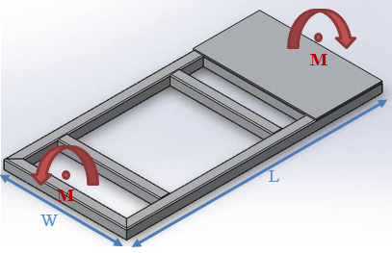
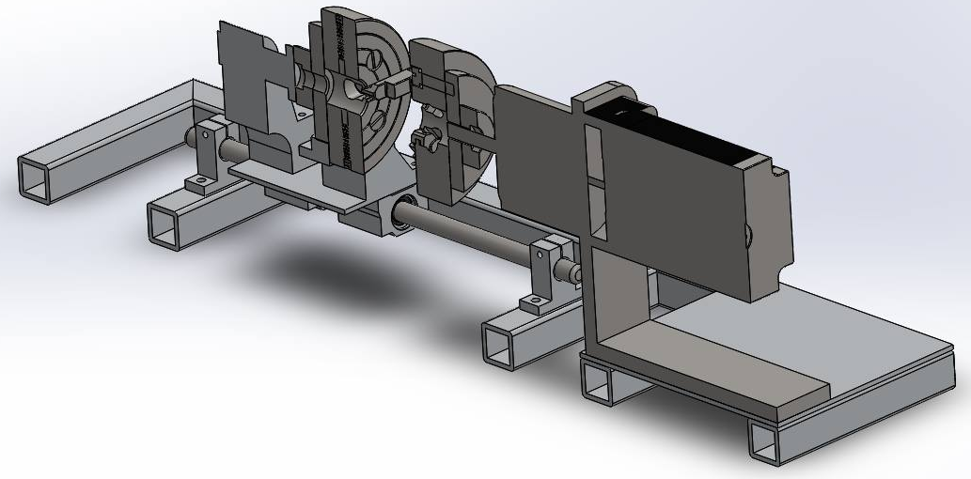
Housing Design
Objectives were to minimize cost, as well as minimize mass
Optimal material: Aluminum
Optimal shape: hollow square shaped cross-section
Figure 20.1: Frame design that minimizes the mass and cost
Figure 20.2: Frame and components cut in half to show the hollow square cross-section of the frame
Brendan Keane

Slide 22
Summary of Optimal Components
Load Generation
  DC Motor with controller
Load Application
  3-Jaw Chuck*
Linear Motion
  2 Rail ball bearing guide
Load Measurement
  Strain Rosette
Housing
  Optimal material: Aluminum
  Optimal shape: Hollow cross section to minimize mass and cost

Slide 23
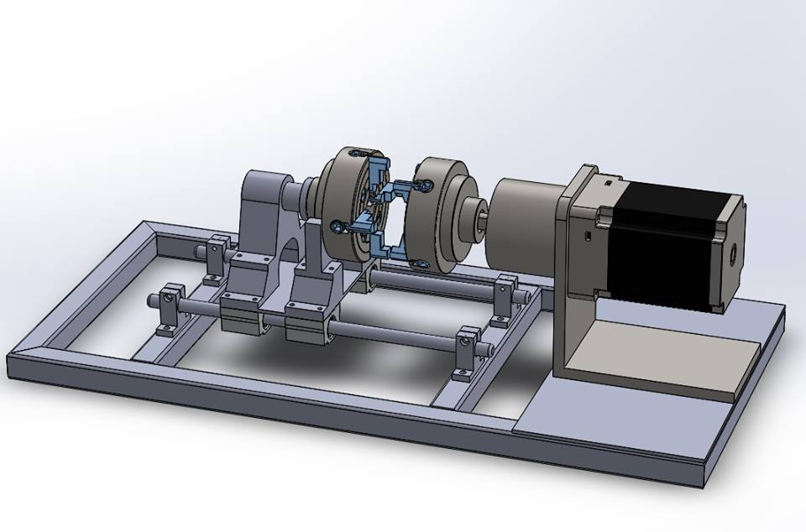
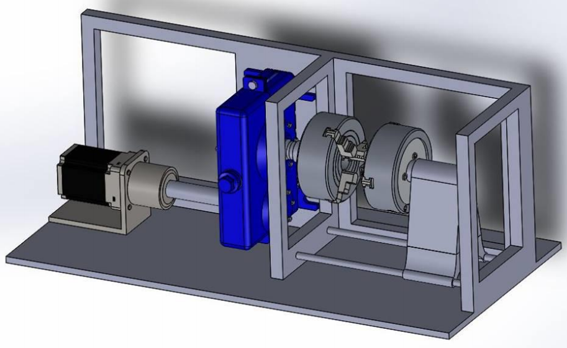
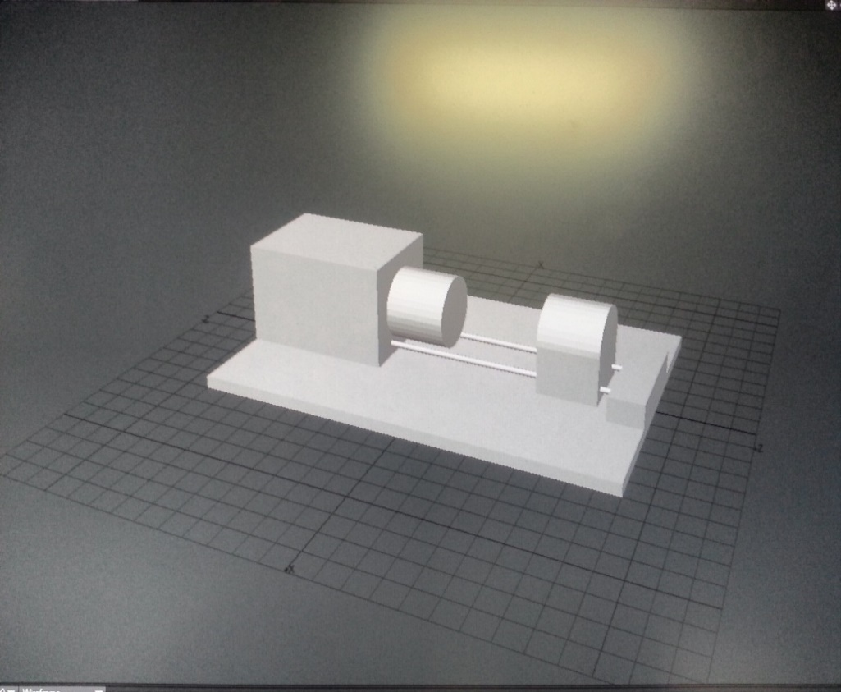
Concept Development
Stage 1: Preliminary 3D modeling to determine general shape
Stage 2: 3D modeling with basic components compiled on a single design
Stage 3: More precise 3D model with almost entirely accurate assembly of necessary parts
Brendan Keane

Slide 24
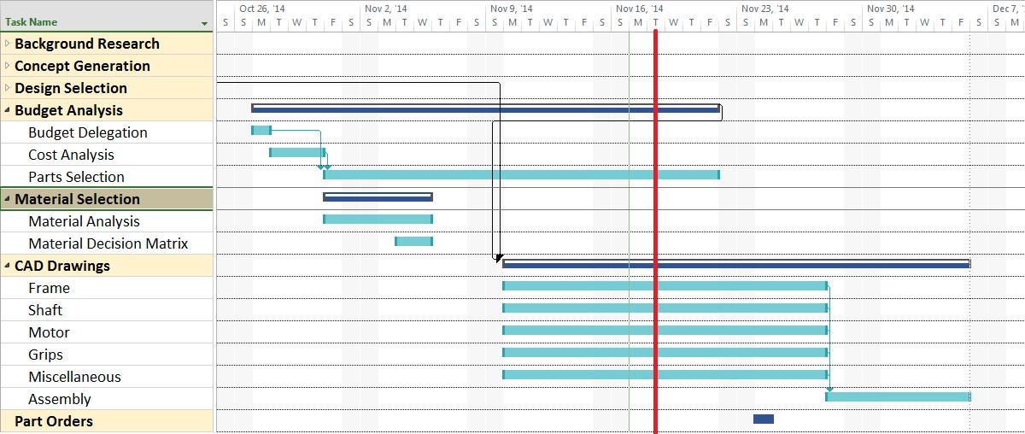
Plan of Action
Brendan Keane

Slide 25
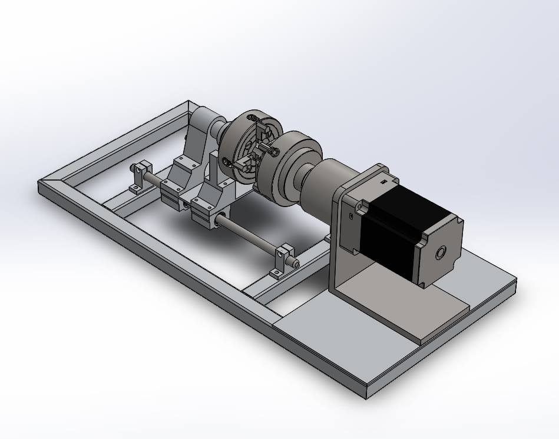
Conclusion
Goal Statement
  Design a more effective way of testing small specimens in free-end torsion.
Components analyzed & selected
  Optimal Design
Next Phase
Figure 24.1: Optimal design selected
Brendan Keane
Notes:
Completion of initial design sketches- Preliminary calculations- Design selection for full CAD build- Full CAD build

Slide 26
Questions?

Slide 27
References
Carter, B. (2008). Texas Instruments: Op Amp Noise Theory and Applications. Retrieved September 22, 2014
Flater, P. (2014). Tabletop Torsion Test. Eglin, FL: Air Force Research Laboratory.
Ilic, M. (2014, October 11). Clamp for centering. Retrieved from GRABCAD: https://grabcad.com/library/stega-za-centriranje-clamp-for-centering-1
Lathe Chuck. (2014, October 7). Retrieved from GRABCAD: https://grabcad.com/library/lathe-chuck-3
Linear Motion Systems. (2014, September 28). Retrieved from Stock Drive Products: https://sdp-si.com/eStore/coverpg/linearmotion.htm
http://www.centuryspring.com/info/spring_measurement.php - spring picture
Brendan Keane

Slide 28
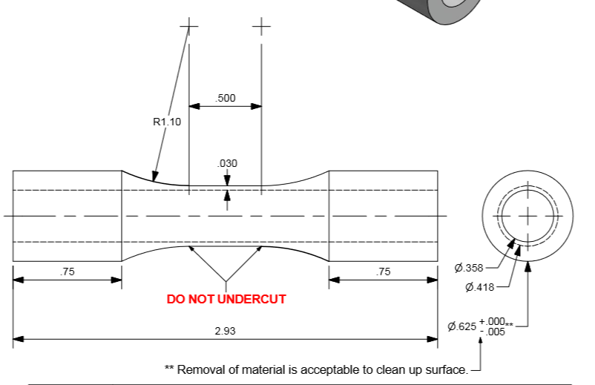
Specimen Dimensions
Brendan Keane

